Slide 1
Literature review : Water Energy Food nexus in dairy farms
Step 1 : define your research question
Step 2: identify relevant keywords
Step 3: choose appropriate databases and resources
Step 4: conduct the search
Step 5: screen and select literature
Step 6: review and analyze the literature
Step 7: synthesize information

Slide 2
Research questions
How is the Water-Energy-Food (WEF) nexus conceptualized and applied in dairy farming systems across different geographic regions?
What are the current approaches and models used to assess the interlinkages among water, energy, and food in dairy farms?
What strategies have been identified in the literature to enhance sustainability in dairy farms through integrated WEF nexus management?
How do water and energy use efficiencies impact milk production and feed sustainability in dairy systems?
What technological and management interventions have been implemented to optimize the WEF nexus in dairy farms, and how effective are they?
How do regional climatic conditions and resource availability influence WEF nexus trade-offs in dairy production systems?
What are the key methodological gaps in existing WEF nexus studies applied to dairy farms?
To what extent have system dynamics or other integrated modeling approaches been used to study the WEF nexus in dairy production?

Slide 3
Identification of keywords

Slide 4
Water-Energy-Food nexus index proposal as a sustainability criterion on dairy farms: https://doi.org/10.1016/j.scitotenv.2023.162507
Water–Energy–Milk Nexus: Empirical Evidence from Saudi Arabia: https://doi.org/10.3390/w16111538
Assessing the eco-efficiency of milk production systems using water-energy-labor-food nexus: https://doi.org/10.1016/j.scitotenv.2024.176812
Scaling the nexus: Towards integrated frameworks for analysing water, energy and food: https://rgs-ibg.onlinelibrary.wiley.com/doi/abs/10.1111/geoj.12256
The Water-Energy-Food Nexus: A systematic review of methods for nexus assessment: https://iopscience.iop.org/article/10.1088/1748-9326/aaa9c6/pdf
Water-Energy-Food (WEF) nexus in agricultural systems: https://doi.org/10.26192/z7y07
Farm-scale water-energy-food-waste nexus analysis for a closed-loop dairy system: https://www.frontiersin.org/articles/10.3389/fenvs.2022.880839/full
An integrative approach for the water-energy-food nexus in beef cattle production: A simulation of the proposed model to Brazil: https://www.sciencedirect.com/science/article/pii/S0959652618325435
Considering agricultural wastes and ecosystem services in Food-Energy-Water-Waste Nexus system design: https://www.sciencedirect.com/science/article/pii/S0959652619314118
The Nexus of Food, Energy, and Water: https://pubs.acs.org/doi/abs/10.1021/jf501496r

Slide 5
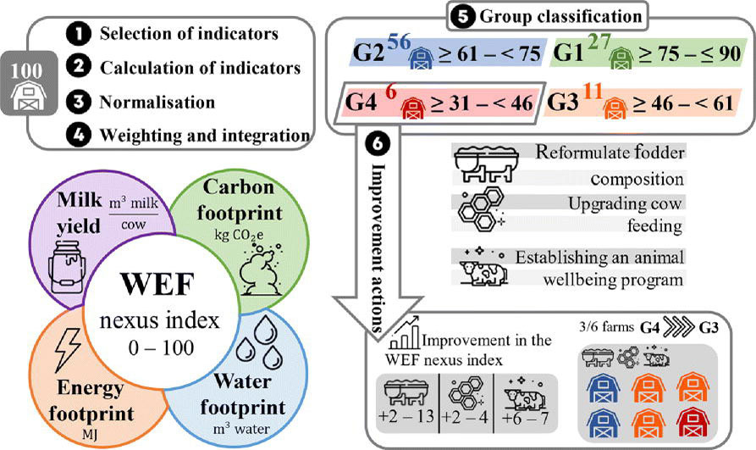
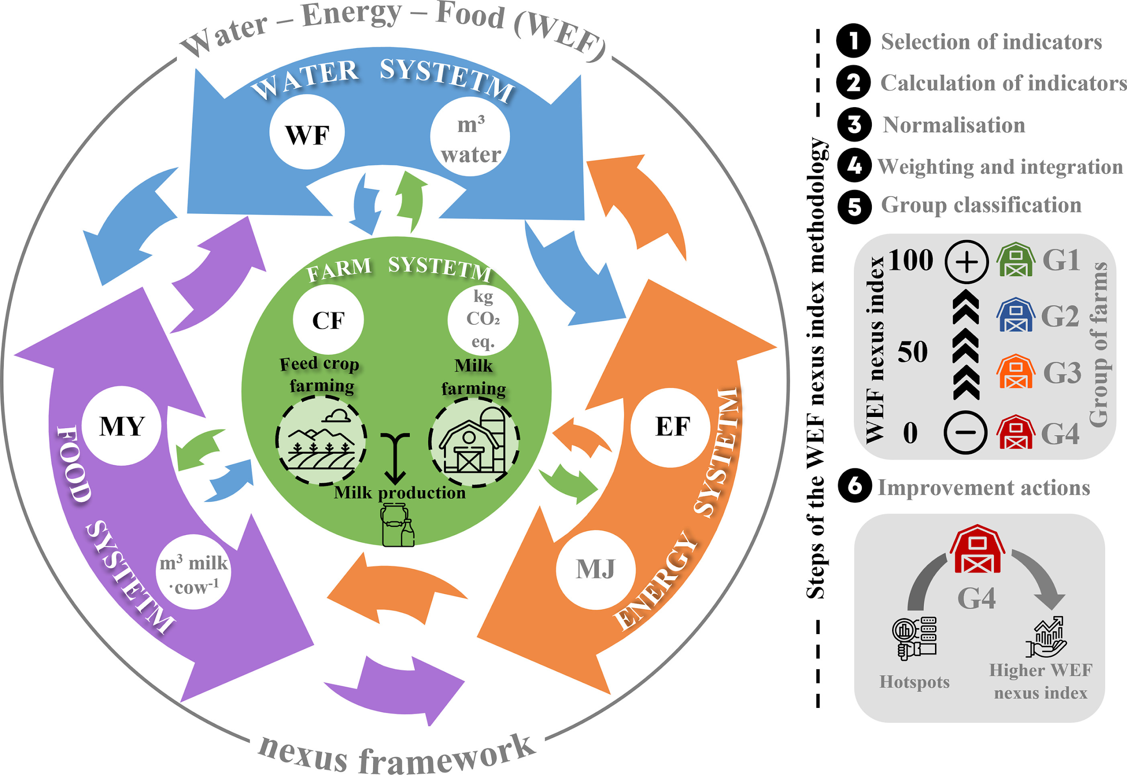
WEF nexus framework (left side) and steps of the methodology followed (right side) for the implementation of a WEF nexus index (varying from 0 to 100) on dairy farms, calculating a series of indicators: carbon footprint (CF, kg CO₂ eq.), water footprint (WF, m³ of water), energy footprint (EF, MJ), and milk yield (MY, m³ of milk per cow), as well as the improvement actions for the group with the worst scores

Slide 6
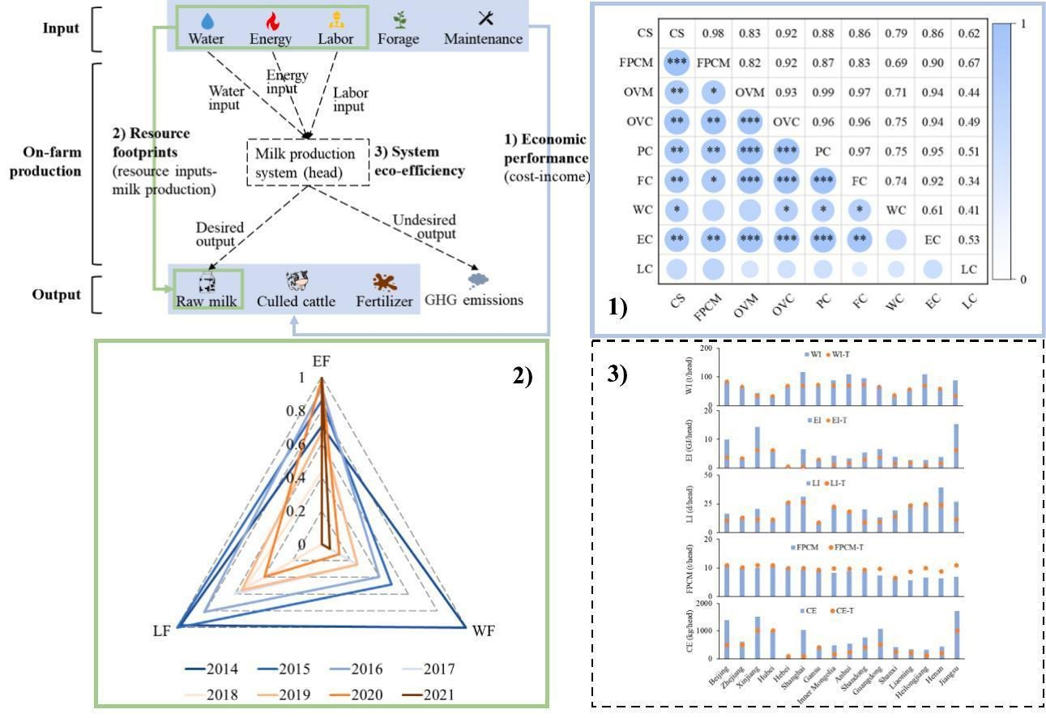

Slide 7
The water-energy-food (WEF) nexus has emerged, and resulted in, significant changes to the way we perceive the interdependencies and feedbacks across the three sectors. Here, we address the data issues that are central to mapping these interdependencies, and provide an assessment of the existing frameworks that are utilised within WEF nexus research

Slide 8
Device | Price | Type | Accuracy
Droplet | $ 199 | Clamp on ultrasonic
Frizzlife LP 365 | $ 300 | Inline smart meter
Flowsmart | $ 199
Ecowitt WFCO1 | $ 99
GoBluTech Flow meter | $ 80 |  | Basic reading, cost effective

